Slide 1
3 Legged 5 Why Analysis
3 Legged 5 Why – Effective Root Cause Analysis
“A Focused Approach to Solving Chronic
and/or Systemic Problems”

Slide 2
What is after Containment????

Slide 3
Agenda
When to Use 5 Why
3 Legged 5 Why Analysis
5 Why Examples
Resources and References
5 Why and Customer Problem Solving Formats
Where to Find the Blank Forms

Slide 4
When to Use 5 Why
Customer Issues
  Required for all Covisint Problem Cases
  May be requested for informal complaints
  May be requested for warranty issues
Internal Issues (optional)
  Quality System Audit Non-conformances
  First Time Quality
  Internal Quality Issue
Notes:
5 Why (also called 3 Leg 5 Why) must be used to:
Determine root cause of all customer WFCCs (Worldwide formal customer complaints)
Also used for customer complaints documented through CSE reports
Required from suppliers for problems document in the Covisint system
May also be used on internal issues – FTQ, Scrap, Internal audit NCRs
Requirement is documented in the Delphi Steering Global Procedure G1738

Slide 5
When to Use 5 Why
5 Why Analysis can be used with various problem solving formats
  Internal Problem Solving
  GM Drill Deep
  Ford 8 D (Discipline)
  Chrysler 8 Step
5 Why, when combined with other problem solving methods, is a very effective tool

Slide 6
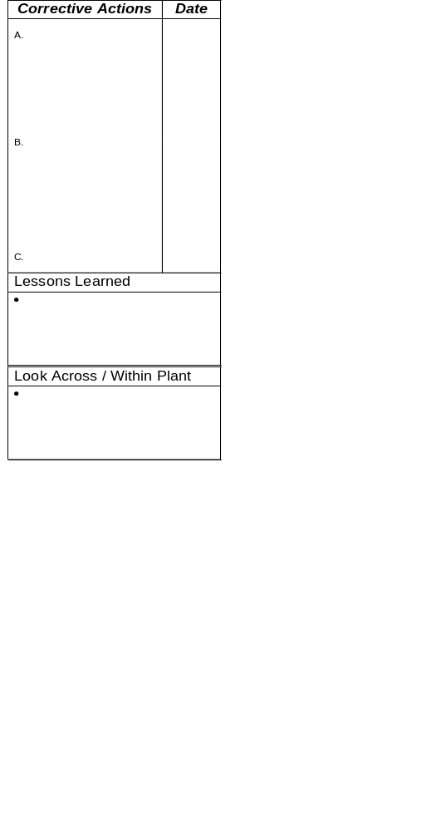
3-Legged / 5-Why Form (Old Format)
Complaint Number: _______________
Issue Date: _____________
Define Problem
Use this path for the
specific nonconformance
being investigated
Why?
Specific
Root Causes
Why?
Why did we have the problem?
Use this path to
investigate why the
problem was not detected
Why?
Detection
Why?
A
Why?
Why?
Why did the problem reach the customer?
Use this path
to investigate the
systemic root cause
Why?
Systemic
Why?
B
Why?
Why did our system allow it to occur?
Why?
Why?
Why?
C
Why?

Slide 7
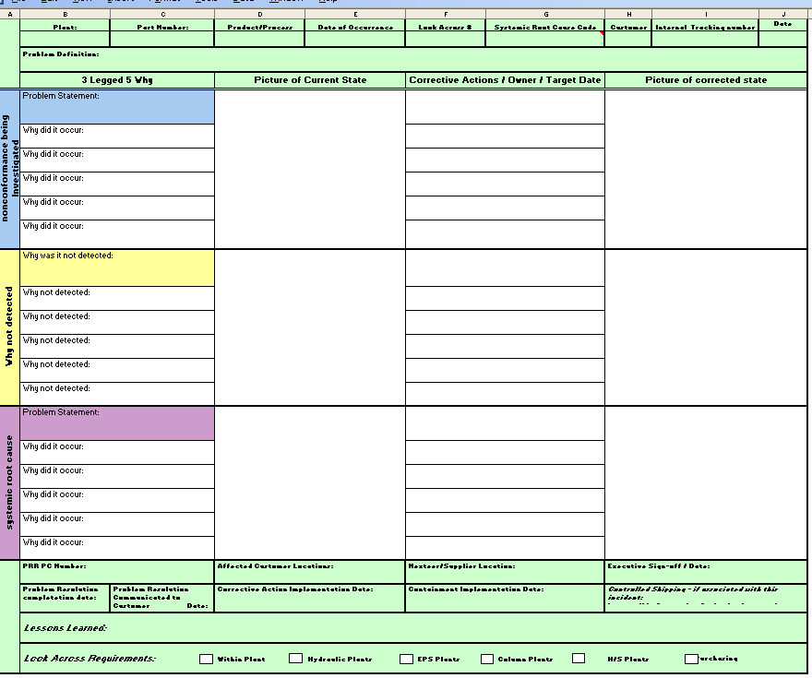
Problem Definition
New Format of 5 Why
Specific
Detection
Systemic

Slide 8
5 Why Analysis
General Guidelines
  A cross-functional team should be used to problem solve
  Don’t jump to conclusions or assume the answer is obvious
  Be absolutely objective
Notes:
Use a cross-functional team whenever possible. Engage manufacturing, engineering, and quality. Possibly even product engineering, and PC & L depending on the issue
Don’t jump to conclusions. Just because you have experienced an issue in the past, don’t assume the same root cause is present. Be objective.
Don’t assume the answer is obvious. This can happen if you don’t follow through on listing the “whys” in a logical order.
Ask why until the root cause is discovered. This may take more or fewer than 5 whys. There is no required number.
Corrective actions for a symptom are usually detective in nature – they will detect, but not eliminate the problem next time it occurs. This is obviously not effective. Finding root cause may allow you to put a preventive action in place.

Slide 9
5 Why Analysis
General Guidelines
  Ask “Why” until the root cause is uncovered
    May be more than 5 Whys or less than 5 Whys
  If you are using words like “because” or “due to” in any box, you will likely need to move to the next Why box
  Root cause can be turned “on” and “off”
    Will addressing/correcting the “cause” prevent recurrence?
    If not what is the next level of cause?
  If you don’t ask enough “Whys”, you may end up with a “symptom” and not “root cause”.
  Corrective action for a symptom is not effective in eliminating the cause
    Corrective action for a symptom is usually “detective”
    Corrective action for a root cause can be “preventive”
  Path should make sense when read in reverse using “therefore”
Notes:
Use a cross-functional team whenever possible. Engage manufacturing, engineering, and quality. Possibly even product engineering, and PC & L depending on the issue
Don’t jump to conclusions. Just because you have experienced an issue in the past, don’t assume the same root cause is present. Be objective.
Don’t assume the answer is obvious. This can happen if you don’t follow through on listing the “whys” in a logical order.
Ask why until the root cause is discovered. This may take more or fewer than 5 whys. There is no required number.
Corrective actions for a symptom are usually detective in nature – they will detect, but not eliminate the problem next time it occurs. This is obviously not effective. Finding root cause may allow you to put a preventive action in place.

Slide 10
Problem Definition
New Format of 5 Why
Specific
Detection
Systemic

Slide 11
Problem Definition
Define the problem
  Problem statement clear and accurate
  Problem defined as the customer sees it
  Do not add “causes” into the problem statement
Examples:
  GOOD: Customer received a part with a broken mounting pad
  NOT: Customer received a part that was broken due to improper machining
  GOOD: Customer received a part that was leaking
  NOT: Customer received a part that was leaking due to a missing seal

Slide 12
Problem Definition
New Format of 5 Why
Specific
Detection
Systemic

Slide 13
Specific Problem
Specific Problem
  Why did we have the specific non-conformance?
  How was the non-conformance created?
  Root cause is typically related to design, operations, dimensional issues, etc.
    Tooling wear/breaking
    Set-up incorrect
    Processing parameters incorrect
    Part design issue
  Typically traceable to/or controllable by the people doing the work

Slide 14
Specific Problem
Specific Problem
  Root Cause Examples
    Parts damaged by shipping – dropped or stacked incorrectly
    Operator error – poorly trained or did not use proper tools
    Changeover occurred – wrong parts used
    Operator error – performed job in wrong sequence
    Processing parameters changed
    Excessive tool wear/breakage
    Machine fault – machine stopped mid-cycle

Slide 15
Specific Problem
What if root cause is?
Operator did not follow instructions
Do we stop here?

Slide 16
Specific Problem
Operator did not follow instructions
Do standard work instructions exist?
Create a standard instruction
Or do we attempt to find the root cause?
Is the operator trained?
Train operator
Were work instructions correctly followed?
Create a system to assure conformity to instructions
Are work instructions effective?
Modify instructions & check effectiveness
Do you have the right person for this job/task?

Slide 17
Specific Problem
Specific Problem
Column would not lock in tilt position 2 and 4
Tilt shoe responsible for positions 2 and 4 would not engage pin
Shifter assembly screw lodged below shoe preventing full travel
THEREFORE
Screw fell off gun while pallet was indexing
WHY??
Magnet on the screw bit was weak
Exceeded the bits workable life

Slide 18
Specific Problem
Specific Problem
Loss of torque at rack inner tie rod joint
Undersized chamfer (thread length on rack)
Part shifted axially during drill sequence
THEREFORE
Insufficient radial clamping load. Machining forces overcame clamp force
WHY??
Air supply not maintained
Various leaks, high demand at full plant capacity, bleeder hole plugs caused pressure drop

Slide 19
Problem Definition
New Format of 5 Why
Specific
Detection
Systemic

Slide 20
Detection
Detection:
  Why did the problem reach the customer?
  Why did we not detect the problem?
  How did the controls fail?
  Root Cause typically related to the inspection system
    Error-proofing not effective
    No inspection/quality gate
    Measurement system issues
  Typically traceable to/or controllable by the people doing the work
Notes:
The 3 Legged or 3 Tiered 5 Why allows us to solve 3 aspects of the problem – the specific issue, why it was not detected, and what failed in our system to allow it to happen.
First leg is the path of problem solving that we typically think of. It is the path we followed before using the 3 Leg 5 Why. Using the second two legs, we get into more depth in problem solving.

Slide 21
Detection
Detection
  Example Root Causes
    No detection process in place – cannot be detected in our plant
    Defect occurs during shipping
    Detection method failed – sample size and frequency inadequate
    Error proofing not working or bypassed
    Gage not calibrated

Slide 22
Detection
Detection
Column would not lock in tilt position 2 and 4
On-line test for tilt function is not designed to catch this type of defect
THEREFORE
Test for tilt function is applied before shifter assembly
Process flow designed in this manner – would not detect shifter assy screw lodged below tilt shoe
WHY??

Slide 23
Detection
Detection
Loss of torque at rack inner tie rod joint
Undersized chamfer/thread length undetected
THEREFORE
Inspection frequency is inadequate. Chamfer gage is not robust
WHY??
Process CPK results did not reflect special causes of variation affecting chamfer.

Slide 24
Problem Definition
New Format of 5 Why
Specific
Detection
Systemic

Slide 25
Systemic
Systemic
  Why did our system allow it to occur?
  What was the breakdown or weakness?
  Why did the possibility exist for this to occur?
  Root Cause typically related to management system issues or quality system failures
    Rework/repair not considered in process design
    Lack of effective Preventive Maintenance system
    Ineffective Advanced Product Quality Planning (FMEA, Control Plans)
  Typically traceable to/controllable by Support People
    Management
    Purchasing
    Engineering
    Policies/Procedures

Slide 26
Systemic Issue
Systemic
  Helpful hint: The root cause of the specific problem leg is typically a good place to start the systemic leg.
  Root Cause Examples
    Failure mode not on PFMEA – believed failure mode had zero potential for occurrence
    New process not properly evaluated
    Process changed creating a new failure cause
    PFMEAs generic- not specific to the process
    Severity of defect not understood by team
    Occurrence ranking based on external failures only, not actual defects

Slide 27
Systemic
Systemic Root Cause
Column would not lock in tilt position 2 and 4
Detection for tilt function done prior to installation of shifter assembly
THEREFORE
PFMEA did not identify a dropped part interfering with tilt function
WHY??
First time occurrence for this failure mode

Slide 28
Systemic
Systemic Root Cause
Loss of torque at rack inner tie rod joint
Ineffective control plan related to process parameter control (chamfer)
THEREFORE
Low severity for chamfer control
Dimension was not considered an important characteristic – additional controls not required
WHY??
Insufficient evaluation of machining process and related severity levels during APQP process

Slide 29
Corrective Actions
Corrective Actions
  Corrective action for each root cause
  Corrective actions must be feasible
  If Customer approval required for corrective action, this must be addressed in the 5 why timing
  Corrective actions address processes the “supplier” owns
  Corrective actions include documentation updates and training as appropriate

Slide 30
Specific Problem
Corrective Action:
Reset alarm limits to sound if <90 PSI.
  Smith 10/12/10
Disable machine if <90 PSI.
  Jones 9/28/10
Dropped feed on drill cycle to .0058 from .008.
  Davis 10/10/10
Clean collets on Kennefec @ PM frequency
  Smith 10/12/10
Added dedicated accumulator (air) for system or compressor for each Kennefec
  Smith 10/12/10
Verify system pressure at machines at beginning , middle, and end of shift
  Smith 10/12/10
Loss of torque at rack inner tie rod joint
Undersized chamfer (thread length on rack)
Part shifted axially during drill sequence
Insufficient radial clamping load. Machining forces overcame clamp force
WHY??
Air supply not maintained
Various leaks, high demand at full plant capacity, bleeder hole plugs caused pressure drop

Slide 31
Detection
Corrective Action:
Implement 100% sort for chamfer length and thread depth.
  Smith 9/26/10
Create & maintain inspection sheet log to validate
  Davis 8/22/10
Redesign chamfer gage to make more effective
  Jones 11/30/10
Increase inspection frequency at machine from 2X per shift to 2X per hour
  Johnson 10/14/10
Review audit sheets to record data from both ends on an hourly basis
  Davis 10/4/10
Conduct machine capability studies on thread depth
  Jones 9/22/10
Perform capability studies on chamfer diameters
  10/14/10
Repair/replace auto thread checking unit to include thread length.
  10/18/10
Loss of torque at rack inner tie rod joint
Undersized chamfer/thread length undetected
Inspection frequency is inadequate. Chamfer gage is not robust
Process CPK results did not reflect special causes of variation affecting chamfer.
WHY??

Slide 32
Systemic
Loss of torque at rack inner tie rod joint
Corrective Action:
Design record, FMEA, and Control Plan to be reviewed/upgraded by Quality, Manufacturing Engineering
Update control plan to reflect 100% inspection of feature
PM machine controls all utility/power/pressure
Implement layered audit schedule by Management for robustness/compliance to standardized work
Ineffective control plan related to process parameter control (chamfer)
Low severity for chamfer control
Lessons Learned:
PFMEA severity should focus on affect to subsequent internal process (immediate customer) as well as final customer
Measurement system and gage design standard should be robust and supported by R & R studies
Evaluate the affect of utility interruptions to all machine processed (air/electric/gas)
Dimension was not considered an important characteristic – additional controls not required
Insufficient evaluation of machining process and related severity levels during APQP process
WHY??

Slide 33
5-Why Critique Sheet
General Guidelines:
  Don’t jump to conclusions..don’t assume the answer is obvious
  Be absolutely objective
  A cross-functional team should complete the analysis
Step 1: Problem Statement
  State the problem as the Customer sees it…do not add “cause” to the problem statement
Notes:
For reviewing suppliers’ 5-Why as part of the PRR root cause analysis.

Slide 34
5-Why Critique Sheet
Step 2: Three Paths (Specific, Detection, Systemic)
  There should be no leaps in logic
  Ask Why as many times as needed. This may be fewer than 5 or more than 5 Whys
  There should be a cause and effect path from beginning to end of each path. There should be data/evidence to prove the cause and effect relationship
  The path should make sense when read in reverse from cause to cause – this is the “therefore” test (e.g. – did this, therefore this happened)
  The specific problem path should tie back to issues such as design, operations, supplier issues, etc.
  The detection path should tieback to issues such as control plans, error-proofing, etc.
  The systemic path should tie back to management systems/issues such as change management, preventive maintenance, etc
Notes:
For reviewing suppliers’ 5-Why as part of the PRR root cause analysis.

Slide 35
5-Why Critique Sheet
Step 3: Corrective Actions
  There should be a separate corrective action for each root cause. If not, does it make sense that the corrective action applies to more than one root cause?
  The corrective action must be feasible
  If corrective actions require Customer approval, does timing include this?
Step 4: Lessons Learned
  Document what should be communicated as Lessons Learned
    Within the plant
    Across plants
    At the supplier
    At the Customer
  Document completion of in-plant Look Across (communication of Lessons Learned) and global Look Across

Slide 36
5 Why Analysis Examples
Group Exercise
Review a 5 Why using the Critique Sheet and what you have learned
  Note: These are actual responses as sent to our Customers!
  Has probable root cause been determined for:
    Non-conformance leg
    Detection leg
    Systemic leg
  Do corrective actions address root cause?
  Have Lessons Learned/Look Across been noted?
  If any above answers are “no”, what recommendations would you make to the team working on the 3 Leg 5 Why?

Slide 37
Is this a good or bad “Specific” leg?
Missing o-ring
on part number
K10001J
WHY?
Parts missed the
o-ring installation
process
WHY?
Why did they
have to rework?
Parts had to be reworked
WHY?
Operator did not return
parts to the proper process step after rework
WHY?
No standard rework procedures exist
This is still a systemic failure
& needs to be addressed,
but it’s not the root cause.

Slide 38
Is this a good or bad “Detection” leg?
Missing threads
on fastener part
number LB123
WHY?
Did not detect
threads were
missing
What caused
the sensor to
get damaged?
WHY?
Sensor to detect
thread presence was not working
WHY?
Sensor was damaged
WHY?
No system to
assure sensors are
working properly
This is still a systemic failure
& needs to be addressed,
but it’s not the root cause
of the lack of detection.

Slide 39
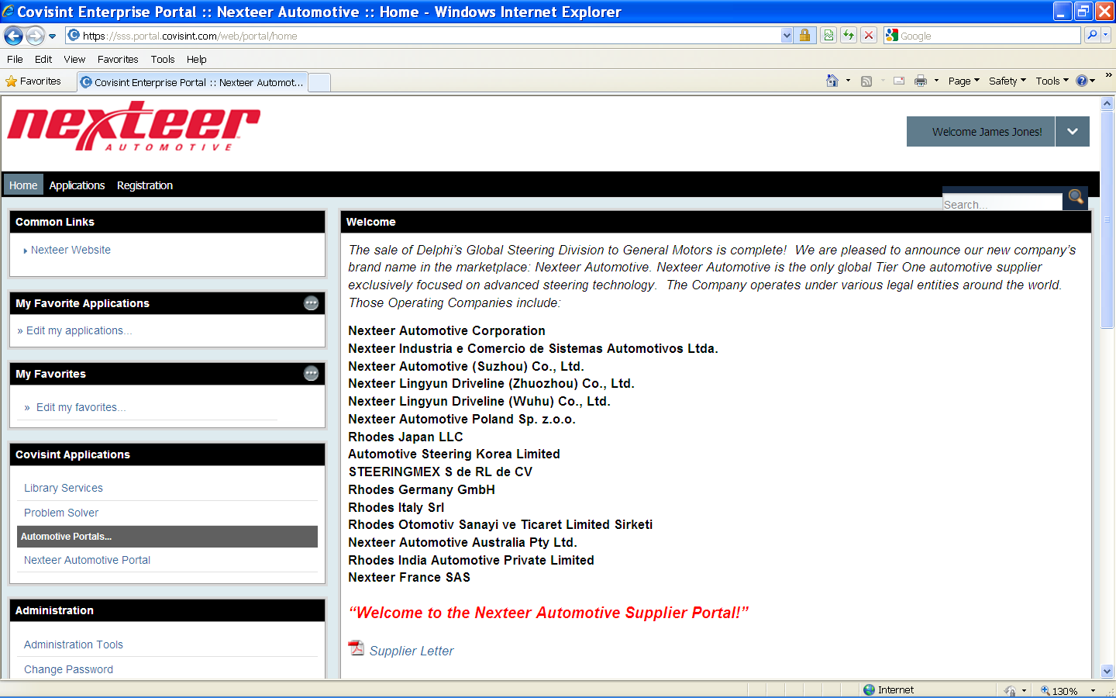
Where to Find Forms…..
Go to Nexteer Supplier Portal in Covisint

Slide 40
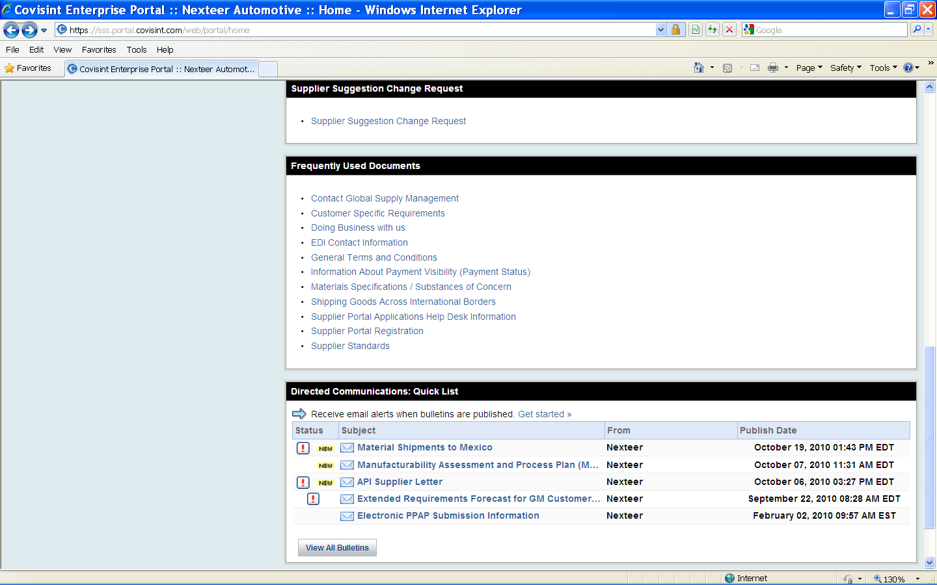
Where to Find Forms….. (cont.)
Click “Supplier Standards” link under “Frequently Used Documents”

Slide 41
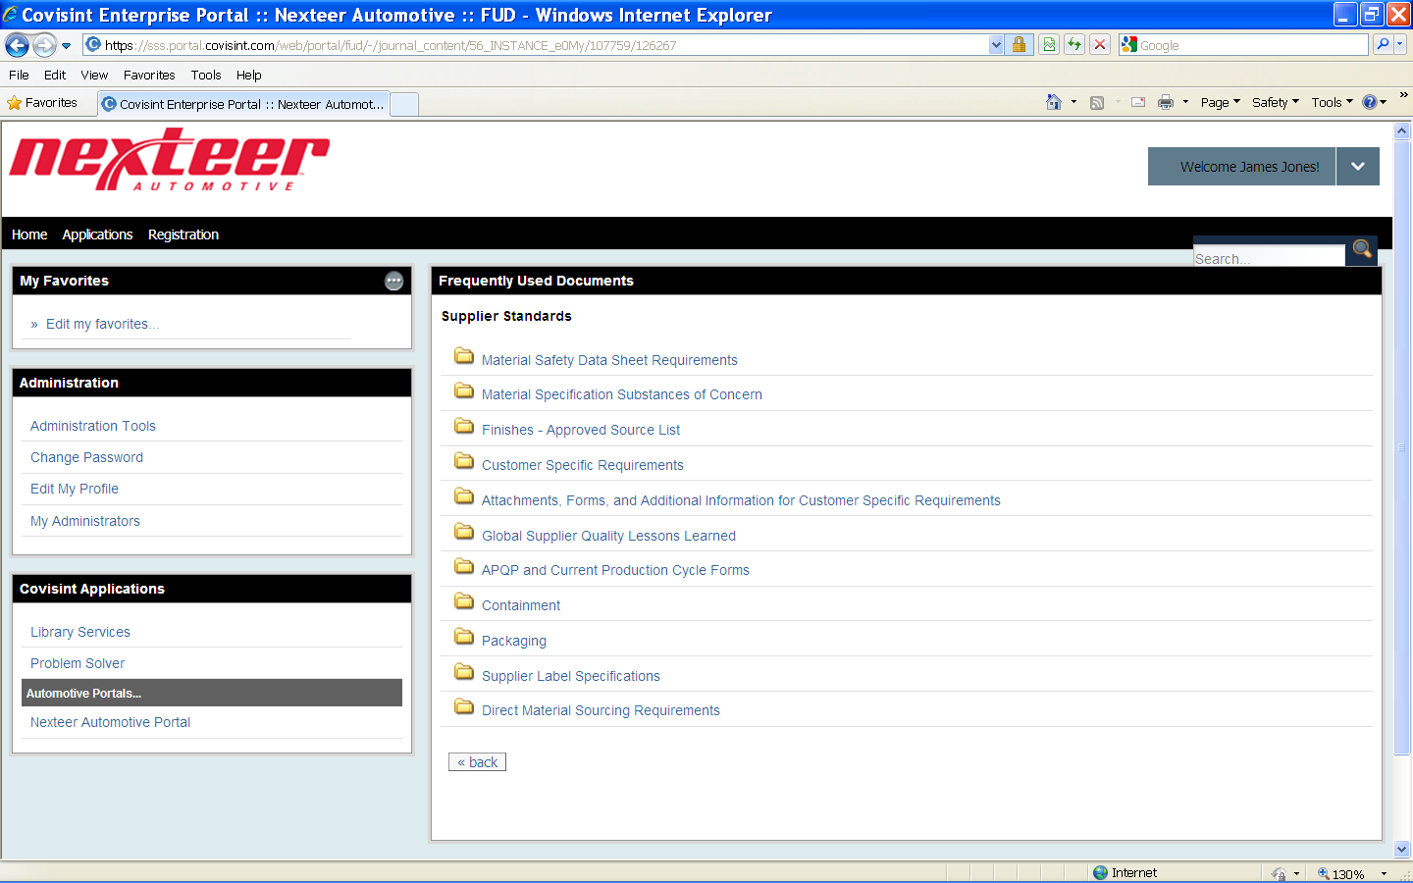
Where to Find Forms….. (cont.)
Click “APQP and Current Production Cycle Forms” link to open the folder containing the 5-why form

Slide 42
Summary of Key Points
When do you use it?
Use a cross-functional team
Never jump to conclusions
Ask “WHY” until you can turn it off
Use the “therefore” test for reverse path
Strong problem definition as the customer sees it
Specific Leg – Typically applies to people doing work
Detection Leg – Typically applies to people doing work
Systemic Leg - Typically applies to support people
  Start with root cause of specific leg
Corrective actions with date and owner
Document lessons learned and look across

